Slide 1
Introduction to Computer Programming
By Dr Shantanu Pathak

Slide 2
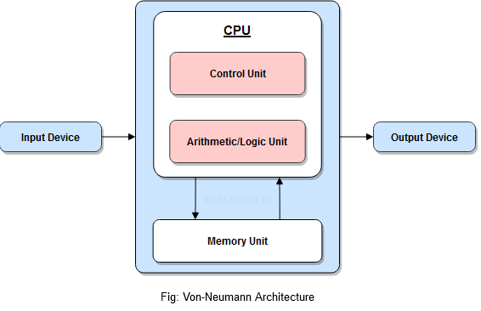
What is a Computer?
Machine used for computations ( mobiles, pcs, laptops, tabs etc)
Basic components
CPU
Memory (RAM, ROM)
Input Output Devices
Hard disk
USB

Slide 3
What is Programming?
Process of instructing computer to perform some tasks using a set of predefined instructions
Program : is user defined sequence of predefined instructions and variables
Instruction : is predefined task CPU can perform (ex addition, subtraction, etc)
Variable : is memory storage for various values used in a program

Slide 4
What is Programming Language?
It is used to write sequence of instructions i..e a program
Levels of Programming Languages
Machine Level (Byte code, Opcodes)
In CPU understandable format
Uses ONLY binary format
Difficult for humans in understand
High Level ( C, C++, Python, JAVA, etc)
Easy for humans to write
Cannot be directly understood by CPU

Slide 5
How a computer program works?
Program contains instructions and variables
Program is stored in memory
CPU takes one instruction (opcode) at a time
CPU uses required variables for that instruction and generates output
Output is stored in a variable
Then CPU takes next instruction
If no instructions further available then program completes (terminates successfully)
If there is an Error then program terminates with error

Slide 6
How a computer program works?
Graphical representation of program is executed by CPU using RAM
How CPU runs opcodes one by one?
How CPU stores variables in RAM (Stack and Heap)?

Slide 7
How to convert high level program to machine level?
High level program (Python, JAVA, C, C++, etc) needs to be converted to byte code (opcode) which is understood by the CPU
Interpreted language:
Convert and execute program line by line
Ex. Linux script (.sh)
Compiled Language:
Convert complete program and then execute complete program
ex. C
Compile and Interpreted:
First complete program is converted to byte code. This byte code is stored in way it can be executed on any machine.
Then byte code is interpreted line by line.
Ex. Python, JAVA

Slide 8
How to convert high level program to machine level?
Graphical representation
Animation: Interpreter vs Compiler
https://youtu.be/e4ax90XmUBc

Slide 9
Compiler vs Interpreter
Home work:
Write difference between the two
Which is best ?
Both have their own advantages and disadvantages
Modern days, compiled and interpreted languages are used which combine best from both

Slide 10
How to verify if program is running correctly? 🡪 Testing
Testing is important part of programming
Checking program for various types of inputs is input
Basic functionality is running
Where program is running correctly
Where program fails
So, we create test cases i..e for given input what is output expected
If the program returns expected output then test case is passed
Ex. Program to check if number is prime or not
Test Case 1: input : 2 => output : prime 🡪 test case pass
Test Case 2: input : 0 => output : Error -> test case fail (Expected output : A prime number (or a prime) is a natural number greater than 1 that is not a product of two smaller natural numbers)

Slide 11
Types (Paradigm) of Programming Languages
Procedural Programming paradigm
Object Oriented Programming (OOP) paradigm
Functional Programming paradigm
And many others
Structured, reflective, logic, etc
NOTE: paradigm means pattern

Slide 12
Programming Paradigms
Procedural Programming Paradigm
Programmer gives sequence of instructions to be executed
These instructions are grouped into procedures
Ex. C program
Object Oriented Programming Paradigm
Here data ( state ) and procedures (instructions) work together
An object maintains its state ( data) and based on state methods ( procedures) they work
Ex. C++ class and object

Slide 13
Programming Paradigms
Functional Programming Paradigm
There are functions defined which map input to other values
Sequence of functions can be applied on a given input one after the other
Working of functions ONLY depends on inputs and no state is maintained (no global variables)
Ex. Common Lisp

